Slide 1
Opportunity-Based Probation
Using the science of adolescent development and behavior change to support youth accountability and achievement

Slide 2
Development Workgroup
The workgroup for developing this model at the Pierce County Juvenile Probation Department include the following members (alphabetically):
Charin Hedstrom, Probation Transformation Coordinator (former member)
Kathy Holland, Probation Supervisor (former member)
Cody Jewell, JDAI coordinator
Susan Miller, Option B Probation
Kate Pearson, Alliances Probation
Angie Thompson, Probation Supervisor (Court lead for OPB project)
Jessica Tran, Probation Counselor
Shelby Zamberlin, SODA Probation (former member)
Pilot members
Andrea Rienzo
Flora Nobles
Susan Miller
Kate Pearson
Facilitator: Dr. Sarah Walker, University of Washington

Slide 3


Slide 4
Traditional Knowledge Translation and Implementation Models (e.g., CDC)
Products are discoveries (either academic or practice-based) that can be disseminated to other sites depending on site fit and readiness
Discovery Efficacy Effectiveness Implementation
Use of Evidence-Based practices with these dissemination models known appears to be going down . . . (Bruns, et al., 2014)

Slide 5
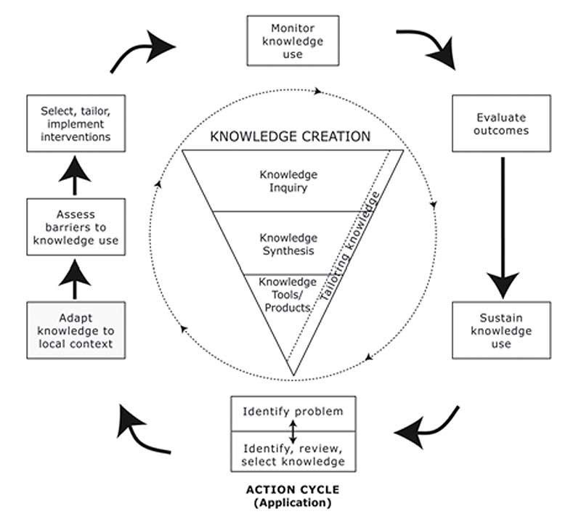
Addressing the Research to Practice Gap
Graham et al. 2006

Slide 6
Co-Design as a Strategy for Accelerating and Sustaining Research Knowledge Transfer
Discovery + Implementation Effectiveness
Principles:
Engage end-users in design
Democratic
Promote ownership, fit and sustainability
Embrace heterogeneity and acknowledge real world complexity up front
Emphasize continuous quality improvement and outcomes
Goodyear-Smith, F., Jackson, C., & Greenhalgh, T. (2015). Co-design and implementation research: challenges and solutions for ethics committees. BMC Medical Ethics, 16(1), 78. doi:10.1186/s12910-015-0072-2

Slide 7
Challenges of CoDesign
Consultant/developer time and costs
Tolerance of ambiguity and role negotiation
Integration of research and practice
Successful transfer of ownership and facilitation
Traditional Implementation and CoDesign best suited to different organizational climates and/or the availability of developed products for a specific need.
Piper D, Iedema R, Gray J, Verma R, Holmes L, Manning N. (2012). Utilizing experience-based co-design to improve the experience of patients accessing emergency departments in New South Wales public hospitals: an evaluation study. Health Serv Manag Res.

Slide 8
Adolescent Science and Juvenile Justice

Slide 9
Development Schedule
Workgroup formed June 2016
Met monthly through present
  Phase 1 meetings: Agreed on values and target population (approx 3 months)
  Phase 2 meetings: Workgroup responds and refines operational suggestions (from UW) (6 months)
  Phase 3: Finalize procedures and pilot testing (6 months)
  Phase 4: Refine procedures and practice for roll out (ongoing)

Slide 10
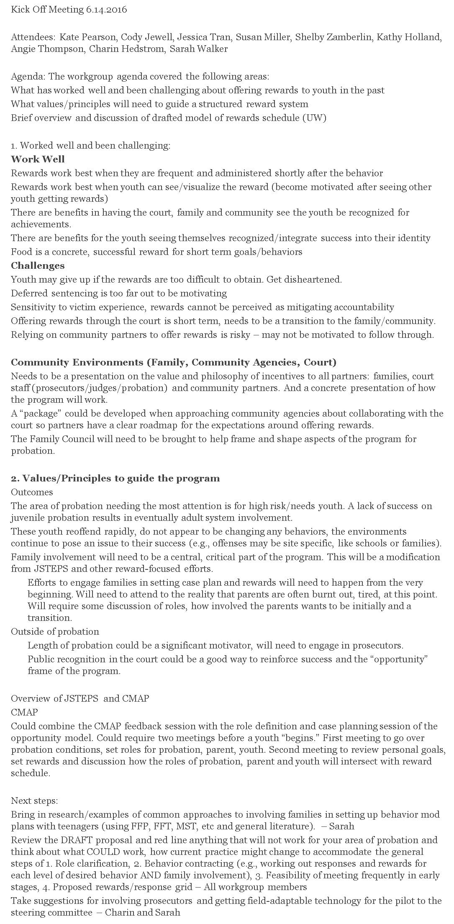
Phase 1: Values and Population

Slide 11
Drive towards independence
Heightened responsivity to rewards
Underdeveloped cognitive control
Underdeveloped “forward thinking”
Sensitive to home environment and parenting
Strongly influenced by peer approval
Adolescent Development

Slide 12
Adolescent Development | Opportunity Based Probation
Drive towards independence | Youth shapes goals and probation plan with the probation officer Probation focuses on connecting youth to community opportunities

Slide 13
Adolescent Development | Opportunity Based Probation
Heightened responsivity to rewards | Success is reinforced with incentives meaningful to the youth

Slide 14
Adolescent Development | Opportunity Based Probation
Underdeveloped cognitive control | Success is frequently and immediately reinforced Violations or problem behaviors are addressed rapidly

Slide 15
Adolescent Development | Opportunity Based Probation
Underdeveloped capacity for forward thinking | Only three goals are monitored weekly Probation officers teach and coach goal setting and problem solving skills

Slide 16
Adolescent Development | Opportunity Based Probation
Sensitive to home environment and parenting | Parent/guardians are engaged upfront as a partner in probation. Parent/guardians are supported to proactively address problem behaviors and reinforce positive behaviors

Slide 17
Adolescent Development | Opportunity Based Probation
Drive towards independence | Youth shapes goals and probation plan with the probation officer Probation focuses on connecting youth to community opportunities

Slide 18
Adolescent Development | Opportunity Based Probation
Strongly influenced by peers | Weekly goal setting and community opportunities support the youths’ transition to prosocial peers and community involvement

Slide 19
Phase 2: Define operations
Define how the family engages
  Caregiver only meeting prior to goal setting
  Caregiver assigns points weekly for compliance with home rules/probation conditions
  Conflict resolution steps as needed
Define how the points add up and what they can be used for
  Calculate math so points suitable for strong and struggling youth
  Define parameters for appropriate rewards, who buys rewards, where are they stored.
  Advocate for reduced probation time as an incentive
Setting appropriate weekly goals
  Integrating with CMAP and balancing the focus on criminogenic needs and positive youth development
  How often do goals need/should change? Shaping goals vs. maintaining goals.
  Address probation requirements vs. weekly goals
Tracking
  Database development (excel infrastructure, field ipads, and cloud based storage)
  Pre and post-adjudication goal tracking

Slide 20
OBP workgroup members solicit feedback from parents, youth, Family Council.
36 youth involved in Pierce County Juvenile Court responding to a survey about meaningful incentives, spring 2016
Notes:
Item Scaling: 1 – 5 (1 = not interested, 5 = very interested)

Slide 21
Community Opportunity
Youth are demonstrating responsibility in probation in order to “earn” an opportunity in the community that furthers their educational and career goals
Currently pursuing options with
  Internships
  Employment
  Paying fees for GED, sports teams, classes, rec center passes
  Visits to college campuses

Slide 22
Phase 3: Piloting
Happening now
  Accumulating lessons learned, e.g., the need for dosing the frequency of contact for youth based on presenting needs.
  Identifying outcome measures
  Qualitative interviews

Slide 23
Phase 4 and Next Steps
August through Oct
UW conducts interviews with youth, caregivers and POs
Roll out of quantitative surveys (also participatory in scale and item construction. Using Skeem and Vidal/Woodward probation relationship questions, Youth Strengths and Difficulties Q, family climate scales).
Summary report in December for recommended modifications, final procedures guide.
OJJDP grant decision in September for randomized stepped wedge evaluation

